Slide 1
Income Limits and Utility Allowances: Issues and Opportunities
Alex Finigan
TCAM
186 Lincoln Street
Boston MA 02111
(617) 542-1200
NCSHA Housing Credit Connect Atlanta 2017
June 22, 2017

Slide 2
Agenda
What’s happening out there?
Income Limits and Utility Allowances: Risks and Issues
Income Limits and Utility Allowances: Opportunities
Best Practices
Additional Thoughts

Slide 3
What’s Happening Out There?
Utility allowance rules and options have become significantly more complicated over time
Monitoring income and rent compliance is complex and time-consuming
Compliance objectives are particularly complicated in properties with multiple layers of subsidy
Factors Affecting Income Limits and Utility Allowances:
  Local and regional differences
  Subsidies: restrictions and options
  Mission and objectives

Slide 4
Income Limits and UAs:
Risks and Issues
Compliance: charging too much rent
Property Operations: markets with slow AMI growth and rising energy prices → utility allowances can reduce revenue
Missed Opportunities: compliance personnel are often primarily focused on downside risk
  Objective is to ensure property is in compliance since risk associated with non-compliance is extensive, with severe penalties
  However, can lead to overly conservative bias / missed opportunities
Generalizations can be dangerous: not all properties in a portfolio are the same

Slide 5
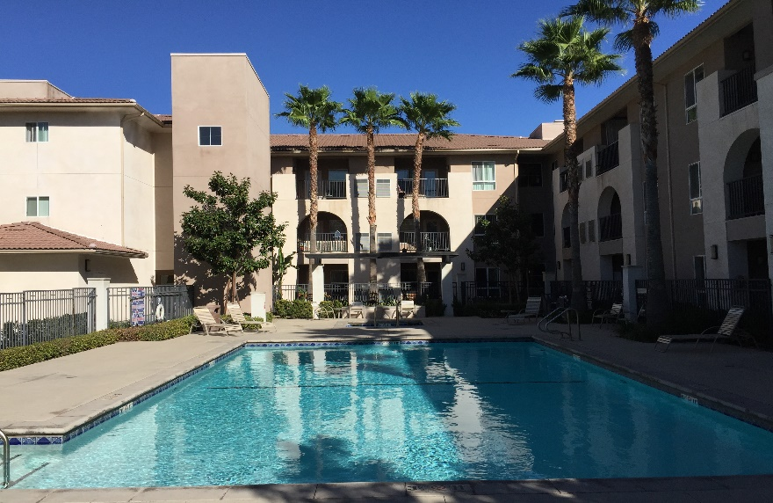
The Risk of Rising UAs – Case Study
90-unit 100% LIHTC property built in 2009 in Los Angeles, CA
Due to income restrictions and on-site services, property operates near 1.0 DSCR
2017 versus 2012:
  Max LIHTC Rents: +$21K (+3.5%)
  UA: +$48K (+100%)!
  Net LIHTC Rents: -$27K (-5.0%)!
All potential revenue growth – and then some – has been consumed by increasing UAs!
Key Issues
Resource-constrained region with rising utility costs
Utility Allowances can consume all top-line revenue growth
For properties operating near 1.0 coverage, expenses must be reduced to compensate
Notes:
Alex – feel free to make this slide work better – but this should give you an idea of what I’m looking for in the Utah example

Slide 6
The Risk of Rising UAs – Case Study
+ Gross Rent
- Net Rent

Slide 7
The Risk of Rising UAs – Case Study
Avg Op Ex
Avg Net Rent
For properties with low operating margins, expenses must be reduced or new funding sources identified – or both

Slide 8
Income Limits and UAs:
Opportunities
Usage Survey:
  New construction properties are often more energy-efficient than local housing authority portfolio → lower utility costs
  UAs based on property survey (conducted by owner or 3rd party) can increase net rent collection
Energy Efficiency:
  Using energy-efficient fixtures and appliances → lower utility costs
  Simple is often best: energy-efficient lightbulbs, low-flow toilets and shower heads, etc.
Streamlined Leasing Process:
  Minimizing time spent on compliance → units are leased more quickly → more revenue and more people are housed
Risk-Based Targeting
  Don’t treat all properties the same
  Dedicate more time to struggling properties or inexperienced management staff
  Dedicate less time to well-performing properties or properties where market rent < LIHTC max

Slide 9
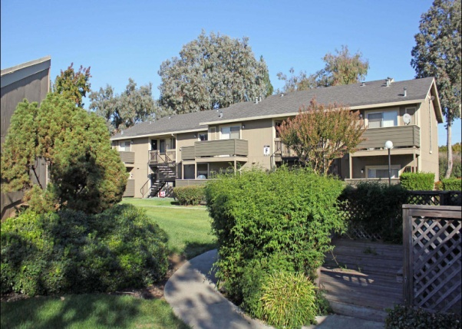
Utility Usage Survey – Case Study
144-unit 100% LIHTC property built in 2004 in Amarillo, TX
Until 2010, using UAs provided by City of Amarillo
Conducted usage survey in 2011
  28% reduction in average UA
  $46K increase in net rent collection
Utility survey worked because:
  Property is newer than average City public housing stock
  Property has been well-maintained with energy-efficient fixtures and appliances
Key Facts
Well-maintained property
Sub-metered electric
Energy-efficient fixtures
Rents at tax credit maximums
Notes:
Alex – feel free to make this slide work better – but this should give you an idea of what I’m looking for in the Utah example

Slide 10
Utility Usage Survey – Case Study
144-unit 100% LIHTC property built in in 2004 in Amarillo, TX
2017 Update:
  Surveyed UAs continue to be less than City UAs
  20% less than average City UA
  $39K additional net rent
Notes:
Alex – feel free to make this slide work better – but this should give you an idea of what I’m looking for in the Utah example

Slide 11
What is Limiting Rents?
Market or restricted rent ceiling?
Restricted rent ceiling or Section 8 rent?

Slide 12
Best Practices: Basics
Without an organized process and an understanding of the documents, maintaining compliance and creating opportunity becomes much more difficult
Organization, consistency and comprehension are essential
  Keep schedule of when new income limits and UAs are published
  Update rents and UAs on time
  Build it into the budget process!
Basics:
  Create easy-reference schedules
  Conduct annual utility surveys (if it makes sense for the property)
  Ensure market studies are updated and rent strategy is thought-out
  Maximize number of Section 8 vouchers

Slide 13
Organized and Updated Records are Crucial

Slide 14
Best Practices: Advanced
Risk-Based Targeting:
  Most properties are not uniform
  Spend less time and fewer resources on the least risky properties
    Good performers in strong markets
    Stable performers where market rents < LIHTC max rents
  Spend more time on the properties that do need it:
    Low-margin performers with rents at max
    Struggling properties or inexperienced management teams
Owners: make sure asset managers have a consistent focus on income opportunities
  Ensure UAs are not too high (without losing sight of downside risk!)
  Rents are maximized (when appropriate)
  Optimal usage of subsidy: Sec 8 vouchers in lowest set-aside units

Slide 15
Additional Thoughts
Compliance can be complicated and is almost always time-consuming – especially in multiple-subsidy properties
More time/$$ spent on compliance → Less time/$$ spent on housing and residents
Steps to lessen compliance burden without undermining program can be beneficial

Slide 16
Income Limits and Utility Allowances: Issues and Opportunities
Alex Finigan
TCAM
186 Lincoln Street
Boston MA 02111
(617) 542-1200
NCSHA Housing Credit Connect Atlanta 2017
June 22, 2017

