Slide 1
Income limits & utility allowances
Tony diblasi, Chief of Asset management
Ohio capital corporation for housing

Slide 2
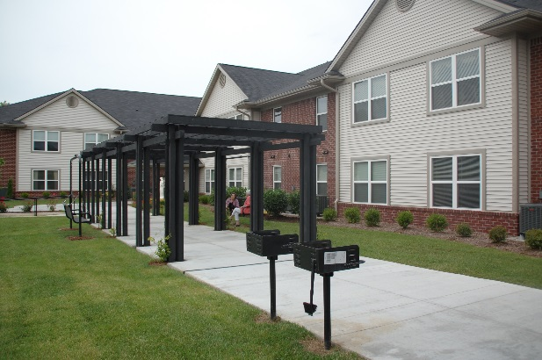

Income Limits & Utility Allowances: The Syndicator Perspective
Major talking points
Holy cow! This is confusing!
LOTS OF RISK if you get it wrong!
Concern for longevity of program

Slide 3


About Ohio Capital Corporation for Housing
OCCH is an independent nonprofit corporation founded 1989
OCCH’s mission is: “to cause the construction, rehabilitation, and preservation of affordable housing” – Ohio and Kentucky are primary focus
Primarily a LIHTC syndicator
  $3.75B in equity investments
  750 affordable housing projects
  40,000 units of affordable housing

Slide 4

Asset Management & Compliance Teams
OCCH Compliance Team
  3 FTEs / 2 outside consultants to help with ‘overflow’
  Reviewed ~8,800 tenant files in 2016
OCCH Asset Management Team
  9 FTEs / 2 support persons
  Inspected 5,400 units in 2016

Slide 5
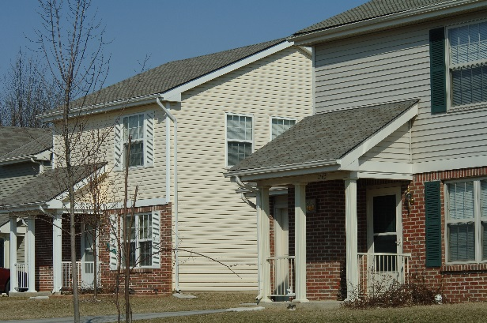
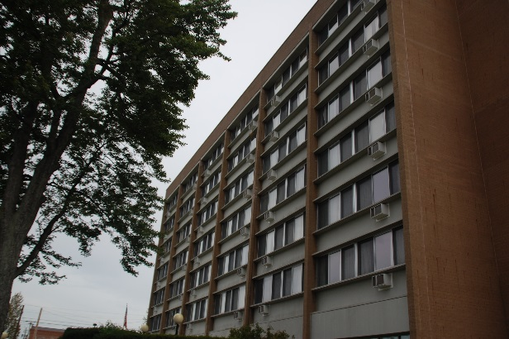
Holy cow! Income Limits are confusing!
Back in the ‘good old days’…
  We had ONE income limit that was published annually…life was much easier
NOW we need to go through a decision tree matrix to identify the correct income limit! Not fun!
  HERA Special or Hold Harmless?
  MTSP vs. National Non-Metro Median Income?
  PIS Date really matters!
Thank goodness for Novoco.com

Slide 6

Holy cow! Utility Allowances are confusing!
Back in the ‘good old days’…
  You circled the applicable allowances from the PHA’s published utility allowance schedule and called it a day!
NOW many projects need to do lots of work to identify the appropriate utility allowance! Not fun!
  Administrative burden to complete HUD-assisted utility analysis
  Engineered utility allowances?

Slide 7
Holy cow! Utility Allowances are confusing!
HOME units no longer permitted to use PHA allowances
  HUD provided notice saying “…methods used by PHAs to establish these utility schedules vary across the county and therefore, may generate inconsistent or inaccurate allowances.”*
  WHAT??? Instead of fixing the PHA accuracy problem…let’s create a new work around!
  Voucher holders REQUIRED to use PHA allowance…but prohibited from HOME
Economic hardship! Suppresses revenue for project!
* HOMEfires – Vol 13 No.2, page 1, May 2016

Slide 8

LOTS OF WORK
Community Properties of Ohio (an affiliate of OCCH)
  PBS8 property – scattered site with MANY unit types / floor configurations
  Engaged in a lengthy and painful process to conduct analysis based on actual consumption (unable to do small sample sizes, due to varying unit configurations)
  Ultimately, reduced utility allowances ~$800K across 823 units (~35% reduction) but change is ‘revenue neutral’ with shift between tenant and subsidy received

Slide 9
LOTS OF RISK if you get it wrong!
Charging a rent that exceeds the maximum allowable rent
  Guide for Completing Form 8823, P 11-10: “Once a unit is determined to be out of compliance with the rent limits, the unit ceases to be a low-income unit for the remainder of the owner’s tax year. A unit is back in compliance on the first day of the owner’s next tax year if the rent charged on a monthly basis does not exceed the limit. An owner cannot avoid the disallowance of the LIHC by rebating excess rent or fees to the affected tenants.”

Slide 10

LOTS OF RISK if you get it wrong!
Easiest way to not maintain minimum set-aside? USE THE WRONG UTILITY ALLOWANCE on a ‘tight’ project!
  Guide for Completing Form 8823, P 18-11: “A unit is considered back in compliance when the rent charged is reduced and correctly reflects the utility allowance. The date of correction is date that the rents correctly reflect the utility allowance.”

Slide 11
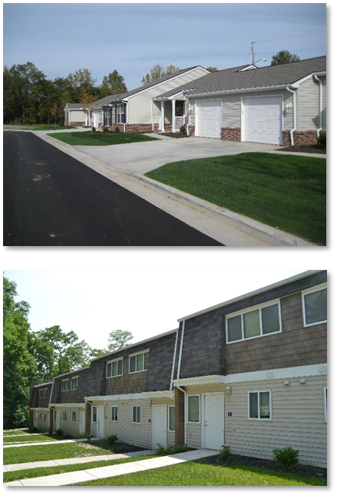
LOTS OF RISK if you get it wrong!
Admitting applicants who are over-income (out of compliance until new certification is completed)
  Guide for Completing Form 8823, P 4-35: “Income Ineligible Households: The household may be income certified as if it were a new move-in. If the household is eligible under the applicable move-in income limit in place on the date of the new certification, then the unit would be considered back in compliance.”

Slide 12
LOTS OF RISK if you get it wrong!
Failing to follow the Next Available Unit rule
  Guide for Completing Form 8823, P 14-6: “Once the Available Unit Rule has been triggered, the noncompliance can be corrected by renting any combination of market rate units, over-income units, and out of compliance low-income units as rent restricted units to income-qualified households until the applicable fraction upon which the credit amount is based is restored. The applicable fraction can also be restored if:
      The tenant’s income decreases to an amount below 140 percent of the income limit in place, or
      The AMGI increases to an amount, such that 140 percent of the income limit is more than the tenant’s income.

Slide 13
Concern for longevity of program
Things are considerably more complex than they were 10 years ago
New regulations openly criticizing methodologies of other aspects of the program
Is program at risk of ‘collapsing’ under its own weight?
Can we find thoughtful, elegant solutions to reduce these burdens?

Slide 14

Thank You!

