Slide 1



Evaluating Utility Allowance Options

Slide 2
How does the utility allowance option impact maximum allowable rent and project operations?
  Example:
  A three-bedroom allowable rent limit is $825, the utility allowance is $100, the owner charges rent of $725. The total of the rent and utility would be $825, which is equal to the allowable rent limit.
  At a 100 unit property, if the utility allowance increases to $125, then the tenant rent will be reduced to $700 so as not to exceed the $825 allowable rent limit.
  Annual loss of income is $30,000.

Slide 3
How does the utility allowance option impact maximum allowable rent and project operations?
  Example:
  A three-bedroom allowable rent limit is $825, the utility allowance is $100, the owner charges rent of $725. The total of the rent and utility would be $825, which is equal to the allowable rent limit.
  At a 100 unit property, if the utility allowance increases to $125, then the tenant rent will be reduced to $700 so as not to exceed the $825 allowable rent limit.
  Annual loss of income is $30,000.

Slide 4
We analyzed the impact of utility allowance on maximum allowable rents and project operations.
What is the 2 year history of utility allowance changes?
What was the overall affect to property operations?
What are the alternative method options available for each property?

Slide 5
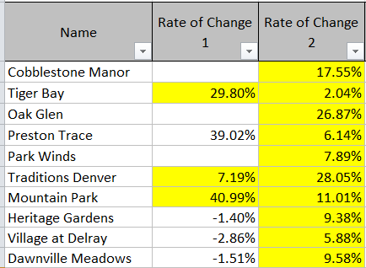
What is the 2 year history of utility allowance changes?

Slide 6
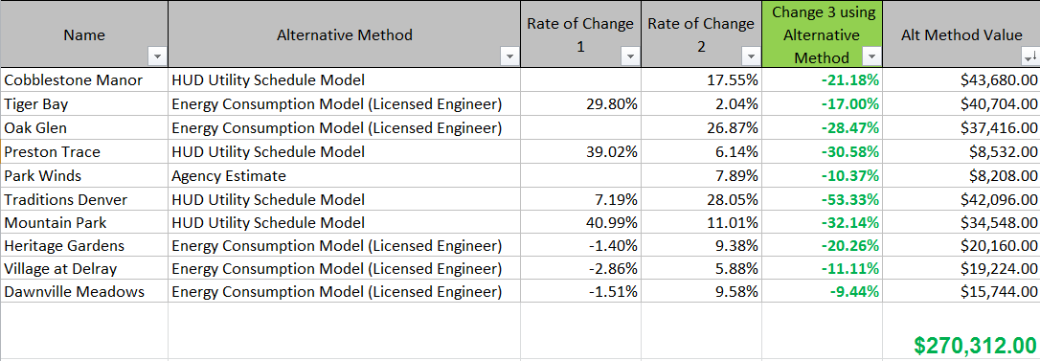
What was the overall affect to property operations?

Slide 7
What are the alternative method available?
Agency Estimate
PHA Schedule
Energy Consumption Model
HUD Utility Schedule Model
Local Utility Company Estimates
** NOT all methods are acceptable in all states~

Slide 8
Agency Estimate and PHA
Pros
Relatively quick
Minimal personnel involvement
No resident involvement
Minimal burden to site staff
Cons
Not property specific
Tends to be higher
Easy- many get married to using this method an don’t want to change

Slide 9
Energy Consumption Model
Pros
Relatively quick
Minimal personnel involvement
No resident involvement
Minimal burden to site staff
Cons
Costly
Architectural drawings are not always available
Finding qualified local engineers can take awhile
Quite a bit of info needs to be provided

Slide 10

HUD Utility Model
Pros
No Cost
No resident involvement
Self-Done- with training
Very effective in states with the power-to-choose rule
Cons
Tariffs can be difficult to find and read
Some states do not accept this method
Also… it’s a bit complicated

Slide 11
Local Utility Company Estimates
Pros
No or limited resident involvement
Minimal personnel involvement
Cons
Many of the utility companies do not offer this service
Process can be slow
Some utility companies may have a small fee for this service
Can be costly if a consultant is required to get the letter.
Likely requires resident signatures
Not all states accept this method

Slide 12
Other times to look at Alternative Methods
Significant change from last year
Property undergoes significant energy conversion that results in decreased utility cost
Property is at or close to maximum allowable rent
Federal or State Agency rule change

