Slide 1

2017 NCSHA Conference
Strategic Performance Management
and Line of Sight Goals

Slide 2


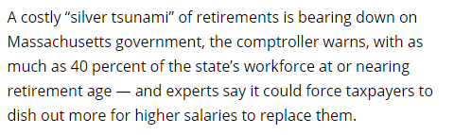
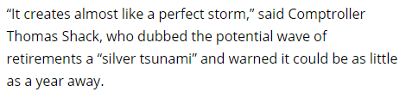

Slide 3
Workforce Analysis
Age & Tenure at MassHousing

Slide 4
Line of Sight Management
Over the past several years, MassHousing engaged in several external and public activities that helped define management challenges relative to staff engagement and corporate culture:
A staff survey was conducted in May 2015
  The survey was negative in a number of areas in particular relative to communications, internal collaboration, accountability and performance management
A Strategic Plan formalized in June 2014

Slide 5
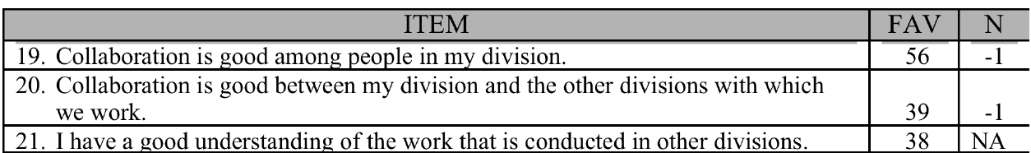
Line of Sight Management
Collaboration needed improvement
*
* “N” represents relationship to “normative values” from other surveyed companies.

Slide 6
Line of Sight Management
  Select Staff Survey Results on performance management reflected a need for greater accountability
  In 2015, only 27% of staff agree that the performance appraisal process is useful in identifying personal strengths and areas for improvement (38% disagree)
  26% of staff agree that poor performance is usually not tolerated
  35% of staff are satisfied with the overall operating efficiency of MassHousing
  Importantly, 71% of staff agree they would like a mentoring program

Slide 7
Line of Sight Management
The Strategic Plan created solid external stakeholder in-put but weak internal resonance
  The Strategic Plan provided very limited opportunities for staff engagement
  Only 14% of staff strongly agreed that they have a good understanding of the Strategic Plan (notwithstanding that about a third of staff participated in the SP Working Groups)

Slide 8

Line of Sight Management
BUSINESS JOURNAL AUGUST 16, 2016
Company Missions: Not Resonating With Employees
A compelling purpose drive companies toward positive business outcomes, give employees something to aspire to, and inspire customers to a deeper personal and emotional attachment to companies' products, brands or services
The problem is that just four in 10 employees worldwide strongly agree that the mission or purpose of their company makes them feel their job is important
What can leaders and managers do about this? For starters, they need to make these statements more than words on a wall or a few paragraphs in their employee handbook. They must ensure that employees understand the company's purpose and can relate it to their individual work

Slide 9
Line of Sight Management
An internal process was conducted to identify the key elements of Agency mission

Slide 10
Line of Sight Management

Slide 11
Line of Sight Management
BUSINESS JOURNAL SEPTEMBER 13, 2016
Our research also shows that in many companies, gaps exist between the desired culture and the culture that employees experience.
Gaps create inconsistency and confusion for employees and customers.
The most successful companies identify these gaps and implement strategies, systems and processes that reduce them.
To shift their culture from what is to what could be, leaders need to ensure that the culture is:
Clearly defined, communicated and managed
Quantified
Intentionally managed

Slide 12
Line of Sight Management
An internal process was also conducted to identify key corporate values

Slide 13
Line of Sight Management

Slide 14
Line of Sight Management

Slide 15
Line of Sight Management

Slide 16
Home Ownership | 2020 Goals
Loan Amount
MIF
$3,000,000,000
$500,000,000
$2,400,000,000
$400,000,000
$1,800,000,000
$300,000,000
$1,462,390,212
$1,200,000,000
$200,000,000
$600,000,000
$100,000,000
(48.75%)
$59,566,655
(11.91%)
$0
$0
As of September 26, 2017

Slide 17
Home Ownership | 2020 Goals
New Borrowers
Borrowers <80%AMI
Minority Borrowers
Gateway Cities
Veteran Borrowers
15,000
6,000
3,000
5,000
300
12,000
4,800
2,400
4,000
240
9,000
3,600
1,800
3,000
180
2,434
(49%)
6,000
2,400
1,200
2,000
120
5,690
(38%)
2,320
(39%)
1,260
(37.43%)
3,000
1,200
600
1,000
60
57
(19%)
0
0
0
0
0
As of September 26, 2017

Slide 18
Rental | 2020 Goals
Number of Developments
Affordable Units
New Production
Loan Amount
$2,000,000,000
200
20,000
2,000
$1,804,632,378
(90%)
$1,600,000,000
160
16,000
1,600
$1,200,000,000
120
12,000
1,200
11,092
(55%)
$800,000,000
80
92
(46%)
8,000
800
$400,000,000
40
4,000
400
430
(21.50%)
$0
0
0
0
As of September 26, 2017

Slide 19
Line of Sight Management
Mission Values Leadership Model 2020 Goals 2017 Goals Staff Goals
Key Features of Line of Sight Management Implementation
Staff member input key to developing Mission and Values and Senior Leadership Team input relative to Leadership model and gap analysis
Direct feedback training and Leadership Development Plans for Senior Leadership Team and their direct reports, about 45 people
Staff-wide training on reviews, goal-setting, feedback, 1-on-1s
More engaging internal communication plan
  Weekly “News and Notes” Internal Communication tool
  Required monthly one-on-one meetings between managers & staff and building infrastructure for “360” feedback

Slide 20
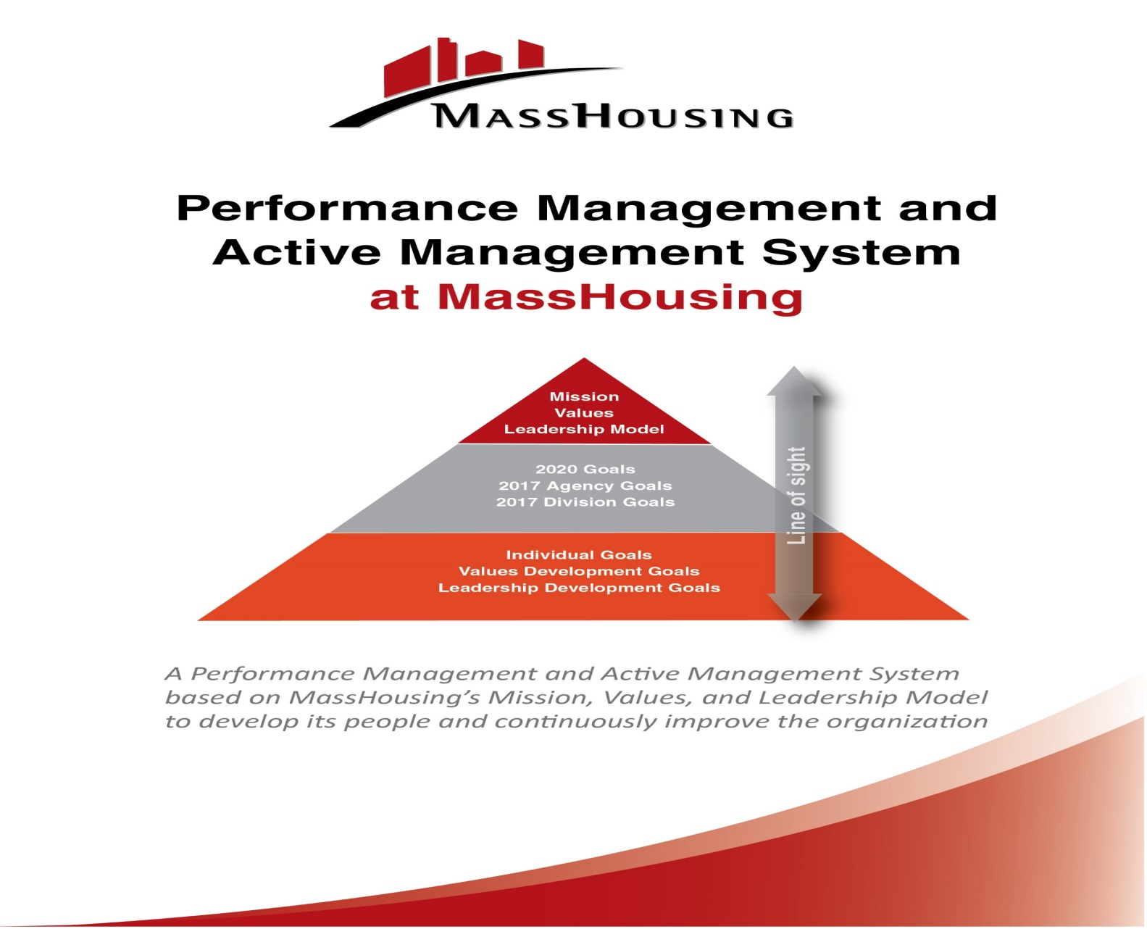
Line of Sight Management

Slide 21
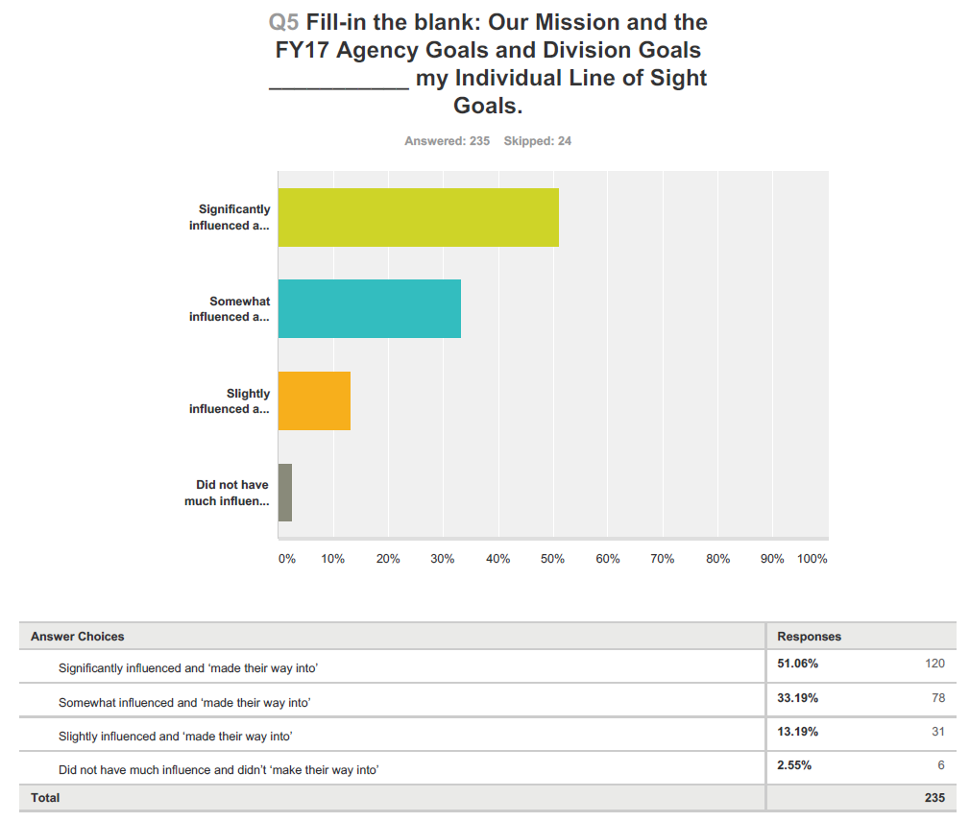

Slide 22
  Implemented a management system built around mission, values, long-term goals, timely annual goals and performance reviews, frequent feedback and merit pay
  2016 staff survey reflect -11% assessment of (old) performance appraisal process as useful in identifying personal strengths and areas for improvement
  2017 survey +44% assessment of (new) system as useful in identifying personal strengths and areas for improvement, representing a 55% improvement in one year

Slide 23
CHAIRMAN’S BLOG FEBRUARY 15, 2017
The old ways -- annual reviews, forced rankings, outdated competencies -- no longer achieve the intended results.
My short answer as to how to transform your workplace culture and engage employees:
1.) Transform your workplace from old command-and-control to one of high development and ongoing coaching conversations.
2.) Don't put your toe in -- dive in. You can afford a lot of mistakes and even failures because the system you currently use doesn't work anymore.
3.) Switch from a culture of "employee satisfaction" -- which only measures things such as how much workers like their perks and benefits -- to one of high development. A "coaching culture.“ Change from a culture of "paycheck" to a culture of "purpose.“
4.) If you have 25,000 employees, then you likely have about 2,500 managers and leaders at various levels. Transform them all

